Slide 1

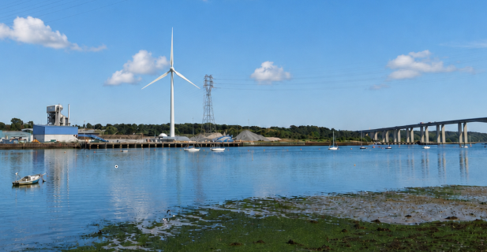
AB Ports Wind Turbine Proposal
in Wherstead
AI generated image
Version 6

Slide 2
Topics
Introductions
What are AB Port’s reasons for installing a Wind Turbine
Status of Application
History of Wind Turbine applications in Wherstead
Location of proposed site
Application Process
Details of Turbine
Comparison of Turbine height
Community Fund
Timeline
Discussion

Slide 3
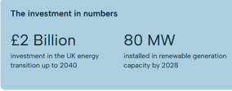
1. Reasoning behind AB Ports wanting to install a Wind Turbine
ABP’s Ready for Tomorrow strategy has been developed in the context of the UK’s legally binding target to reduce carbon emissions to net zero by 2050.
Help control electricity costs and decarbonise ABP and customer operations

Slide 4
2. Status of Application
1) AB Ports have not filed a planning application yet.
2) AB Ports have however asked Babergh to give an ‘Opinion’ if a planning application will need to be supported by an Environmental Impact Assessment. BMSDC’s Planning officer is due to decide by 20th August. This does not involve public consultation.
3) In addition to Wherstead AB Ports are proposing onshore wind turbine projects in:
  Grimsby ~ Multi turbine. Initial application scaled down following site and environmental reviews
  Immingham ~ 17MW In advance planning application phase
  Hull ~ Planning application stage
4) The Wherstead application will specify a blade tip height of up to 150m, AB Ports advise they have not finalised this yet. This will generate approx. 6 MW
5) AB Ports have advised they have collected 1 years worth of wind flow data for the Wherstead site
and have prepared an ornithology study.

Slide 5
3) Wind Turbine in Wherstead History
In 2013 an application was made to install a 130m Wind Turbine land to the south of Pannington Hall Lane. B/13/01476.
This was rejected due to concerns of interference with Air Traffic Control radar at RAF Honington, deficiencies in the environmental statement and insufficient wider public benefit.
AB Ports are aware of this previous application and we can assume they are confident their proposal can address the deficiencies.

Slide 6
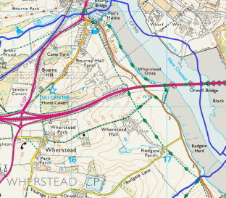
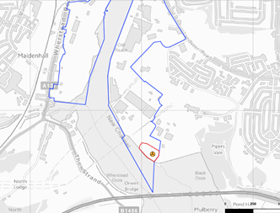
4. Location
Wherstead Parish Boundary crosses the river and encompasses the quay on the North West Bank
Proposed location
Parish Boundary

Slide 7
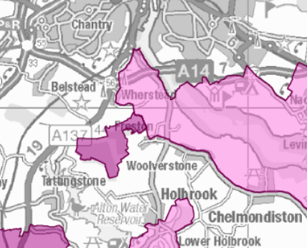
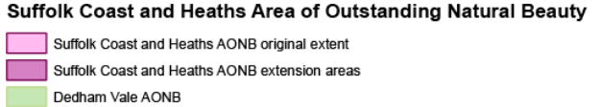
4. Location continued
The site is within the setting of the AONB (National Landscape)
Proposed location

Slide 8
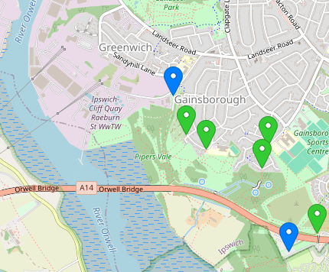
4. Location continued
Pipers Vale Nature reserve
Proposed location

Slide 9
5. Application Process
Environmental Impact Assess Screening concludes 20th Aug
  This can be appealed by the applicant with the secretary of state.
Environmental Impact Assess Scoping, Analysis and mitigation.
Noise, Ornithology, Power yield, LVIA, AONB, Construction and access…
  This can be appealed by the applicant with the secretary of state.
AB Port will hold Public drop in public consultations around the end of September.
Planning application submission Christmas 2026 (includes public consultation).
  The application will not be automatically called before the planning committee.
AB Ports may undertake a pre-application with Babergh
The application will take a minimum of 3 months to decide.

Slide 10
6. Details of Turbine
Three blade turbine with a maximum blade tip height of 150m, with the turbine head able to rotate 360 degree to catch the wind from all directions. The blades should be considered to create a sphere.
The site is only suitable for a single turbine
The existing tall pylons will remain in situ.

Slide 11
AI generated image
7. Comparison
Adjacent Pylons are approx. 80m high & Orwell bridge is 43m high
The Mill in Ipswich is 23 stories and 71m high.
Cranes at Felixstowe & Harwich docks are 85m tall
The only taller structures in Suffolk are the TV masts at Sudbury and Mendlesham

Slide 12
8. Community Fund
AB Ports have advised they will establish a community fund and for every megawatt the turbine generates, a contribution will be made to the community fund.

Slide 13
9. Timeline
Activity | Date
Environmental Impact Assessment Application, EIA | End of July
BMSDC Opinion on EIA need | Aug 20th
EIA Scoping | Sept (indicative)
Planning Application | Christmas 2026 / Jan 2027
Decision | April 2027 soonest.

Slide 14
10. Next Steps
Discussion & Next Steps?

Slide 15
Thank you

